Slide 1
Background
Increasing use of automated systems
Hardware and software technology are improving rapidly
User interface technology is lagging
Critical bottleneck is now user interface, not processing
Two powerful information processors communicating via narrow-bandwidth, highly constrained interface
Goal: Increase bandwidth across channel
Start from human's perceptual abilities, processes, organs
Then work toward devices, interaction techniques, not reverse

Slide 2
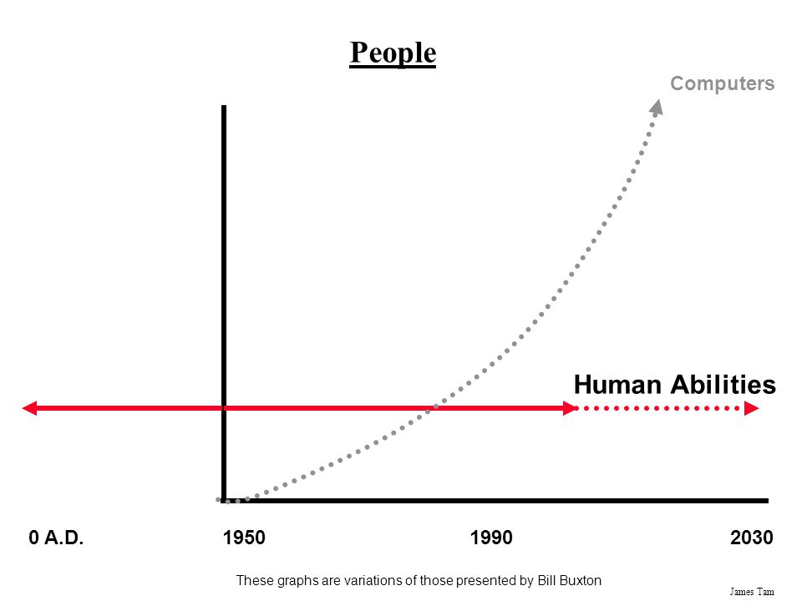
Human Abilities vs. Computer Abilities

Slide 3
Computer Science and HCI
Problems and opportunities in this area increasing, not decreasing, with new technology
Easier to use
Harder to program
Simple engineering methods for good interfaces do not exist yet
Still need iterative development, prototyping, and testing
Hence user interface code is most changeable part of a system

Slide 4
What is a human-conputer interface?
Definition of all inputs from user to computer
Definition of all outputs from computer to user
Definition of sequencing of inputs and outputs
What the user sees/perceives
Not how it is implemented

Slide 5
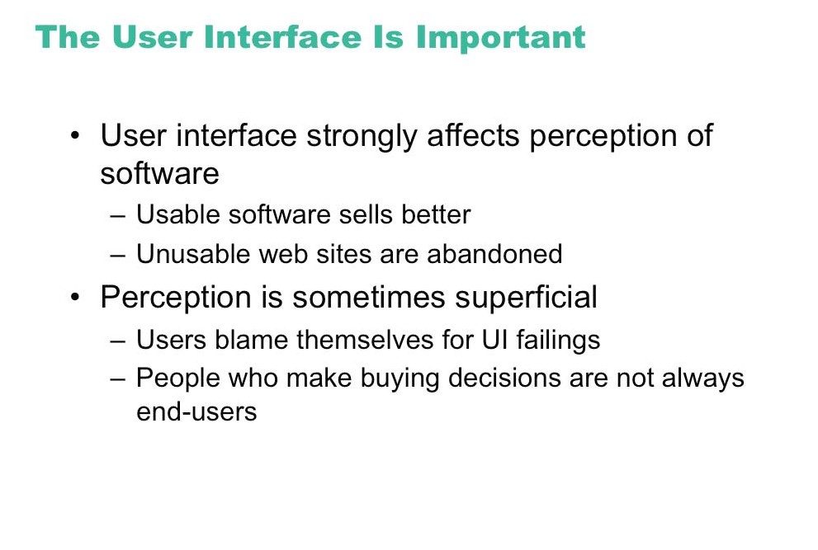

Slide 6
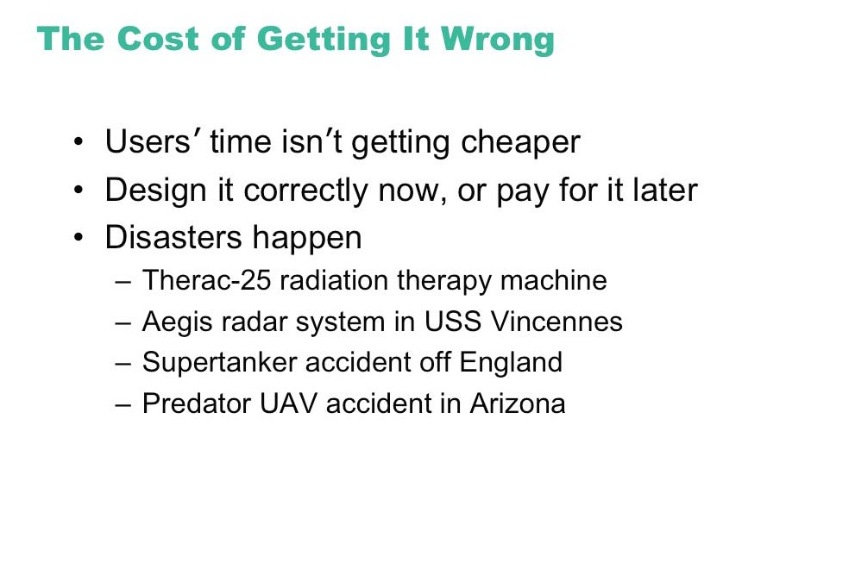

Slide 7
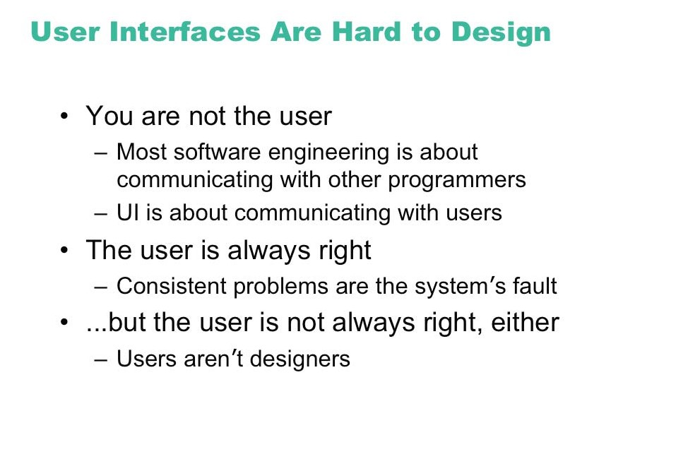

Slide 8
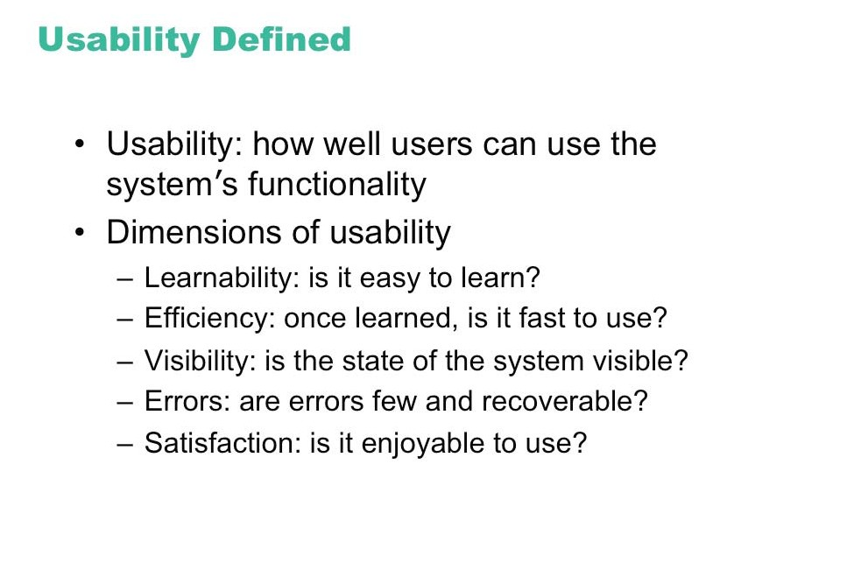

Slide 9
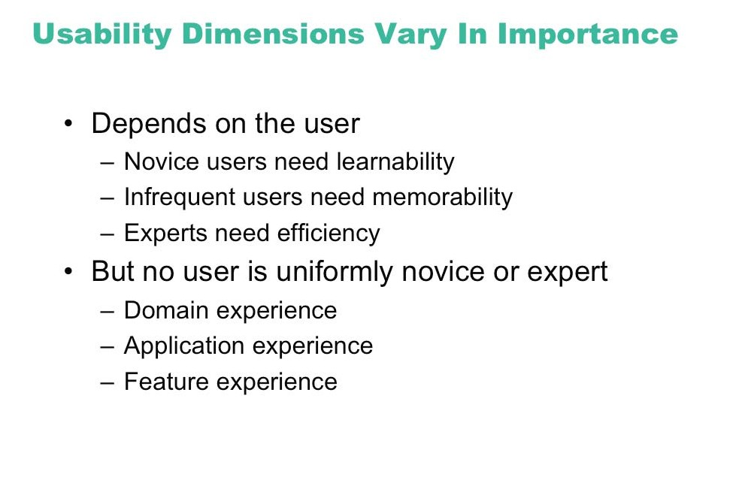

Slide 10
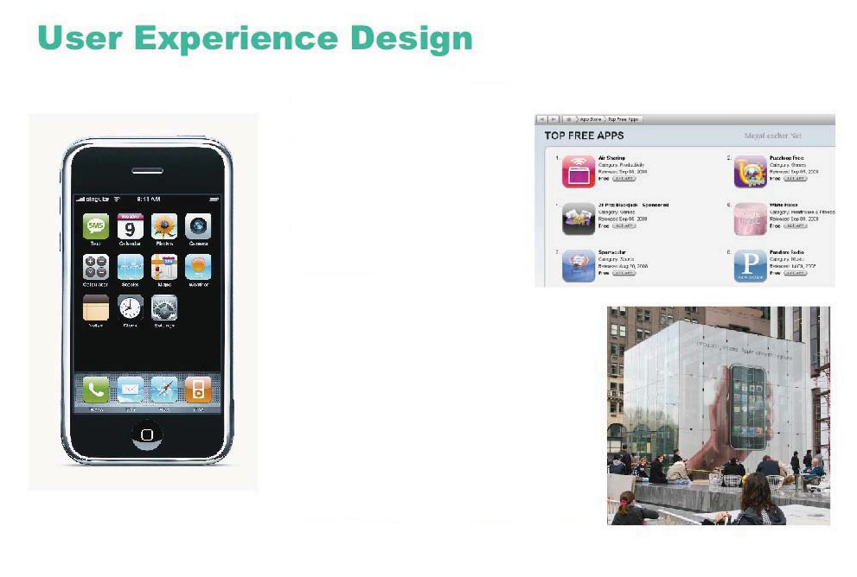
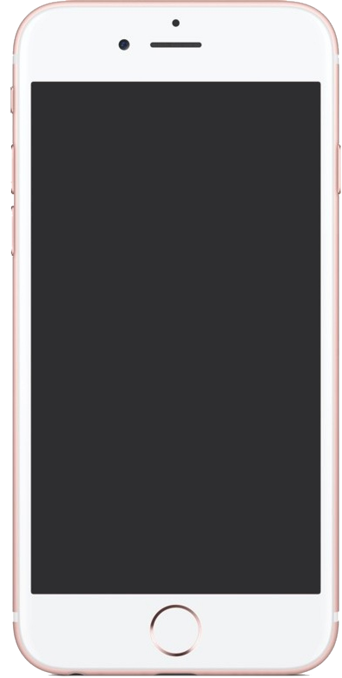
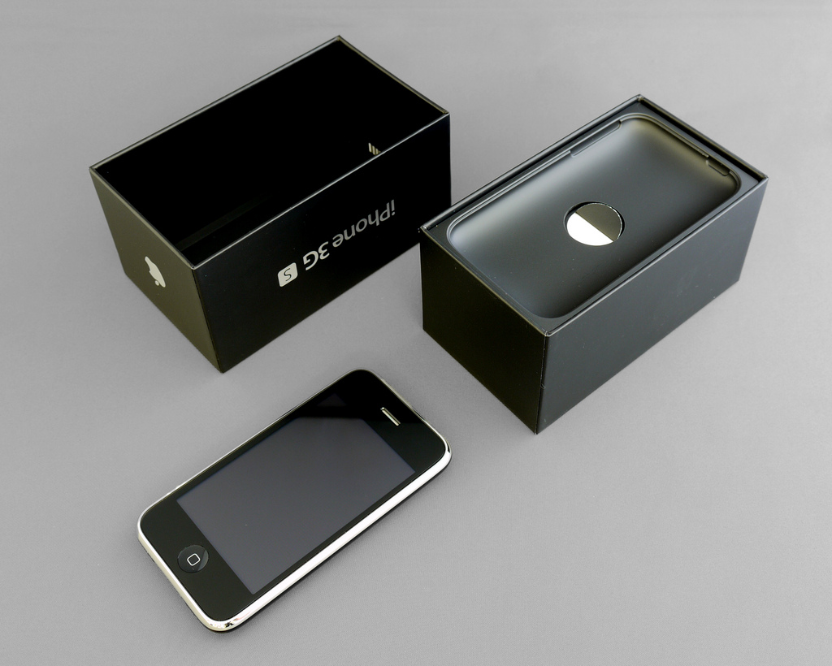
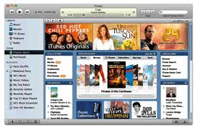

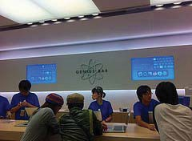
Image courtesy of YU-TA LEE on Flickr.

Slide 11
